Slide 1
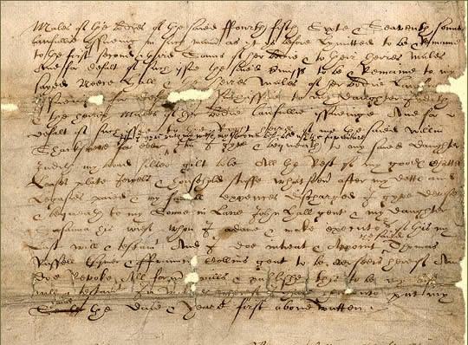
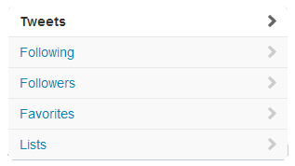
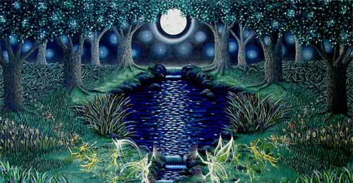
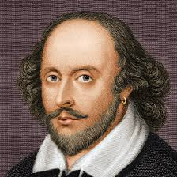
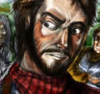
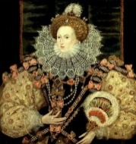
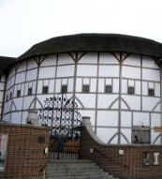
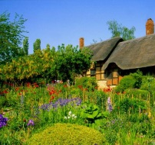
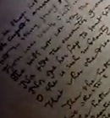
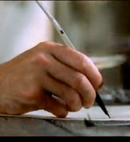
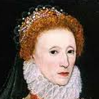
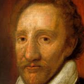
William Shakespeare
@willyshakes
Writes the occasional story and poem
London, UK – http://www.thebard.com
William Shakespeare
@willyshakes
14,234
5,321
3,445,234
William Shakespeare @willyshakes 3m
@QueenLizOne I hope you’ll like my latest work
William Shakespeare @willyshakes 3m
@QueenLizOne I hope you’ll like my latest work
Queen Elizabeth I @QueenLizOne
Followed by TheSheriff and others
Follow
William Shakespeare @willyshakes 3m
@QueenLizOne I hope you’ll like my latest work
James Burbage @TheBurbs
Followed by Blackfriars and others
Follow
William Shakespeare @willyshakes 3m
@QueenLizOne I hope you’ll like my latest work
William Shakespeare @willyshakes 3m
@QueenLizOne I hope you’ll like my latest work
#theplague

Slide 2
William Shakespeare
@willyshakes
Writes the occasional story and poem
London, UK – http://www.thebard.com
William Shakespeare
@willyshakes
14,234
5,321
3,445,234
William Shakespeare @willyshakes 3m
@QueenLizOne I hope you’ll like my latest work
William Shakespeare @willyshakes 3m
@QueenLizOne I hope you’ll like my latest work
William Shakespeare @willyshakes 3m
@QueenLizOne I hope you’ll like my latest work
Queen Elizabeth I @QueenLizOne
Followed by TheSheriff and others
Follow
James Burbage @TheBurbs
Followed by Blackfriars and others
Follow
William Shakespeare @willyshakes 3m
@QueenLizOne I hope you’ll like my latest work
William Shakespeare @willyshakes 3m
@QueenLizOne I hope you’ll like my latest work
#theplague

