Slide 1
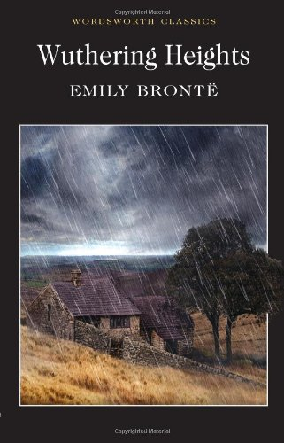
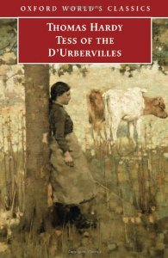

Slide 2
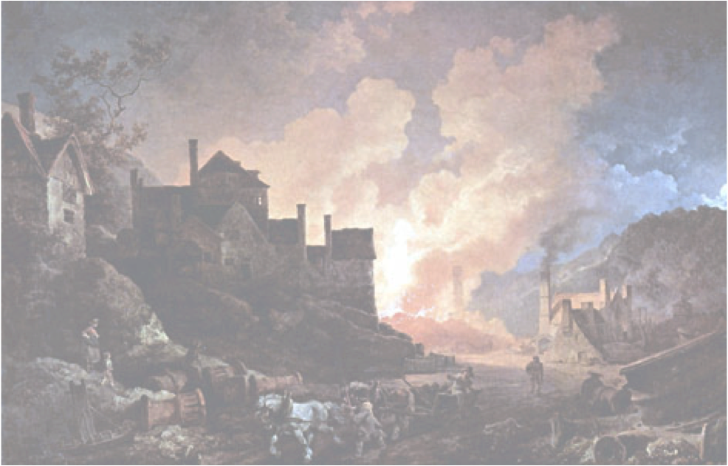
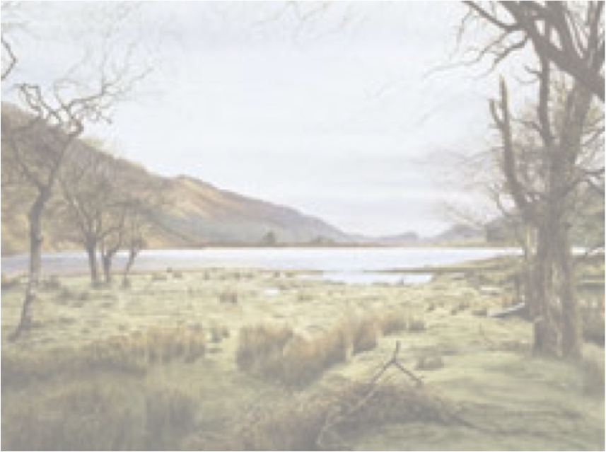
Theme
Nature vs. the Industrial Revolution (or modern society)
Encroaching modernization is a detrimental force and a threat to nature; this conflict is reflected in the settings and people it touches, emphasizing modernity’s wider destructive force.
Settings
Comparison of male suitors
Effects on relationships and love

Slide 3
Setting - Comparing Locations

Slide 4
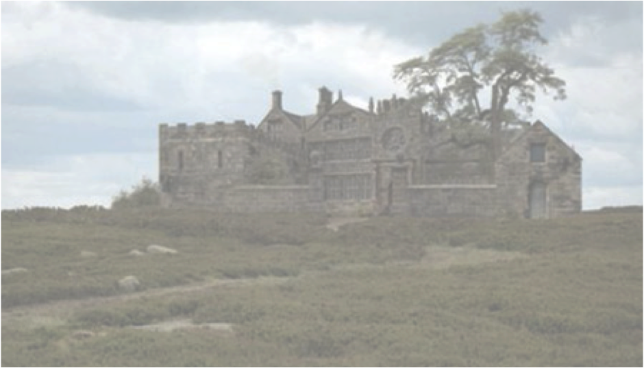
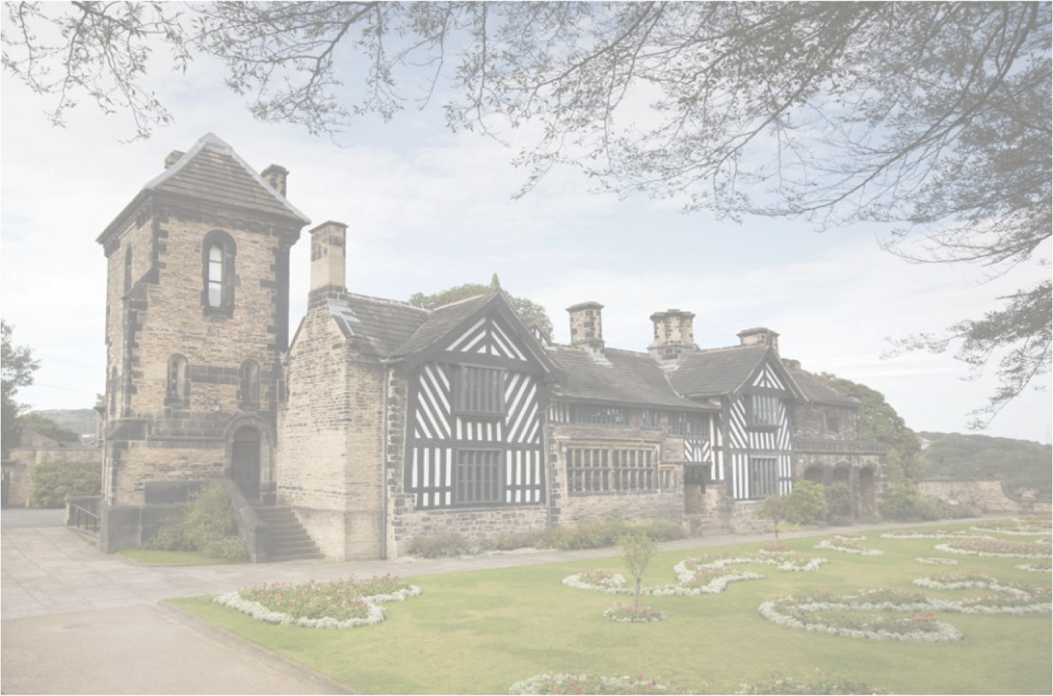
Thrushcross Grange
Wuthering Heights
“Cathy…was too mischievous and wayward”
“She had ways with her such as I never saw a child take up before….Her spirits were always at high-water mark, her tongue always going…A wild, wick slip she was – but she had the bonniest eye, and sweetest smile”
Old, ancestral home; worn down and run down
Inhabitants are fiery, full of life etc.
“[There were] a few stunted firs at the end of the house; and …a range of gaunt thorns all stretching their limbs one way as if craving alms of the sun…the narrow windows were deeply set in the walls, and the corners defended with large jutting stones.”
“Isabella…lay screaming at the farther end of the room…Edgar stood on the hearth weeping silently, and in the middle of the table sat a little dog shaking its paw and yelping, which…we understood they had nearly pulled in two between them.”
Modern, with all the luxuries etc.
Inhabitants though are shallow, weak, whiny etc.
“ah! It was beautiful – a splendid place carpeted with crimson, and crimson-covered chairs and tables, and a pure while ceiling bordered by gold, a shower of glass-drops hanging in silver chains from the centre and shimmering with little soft tapers.”

Slide 5
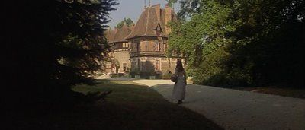
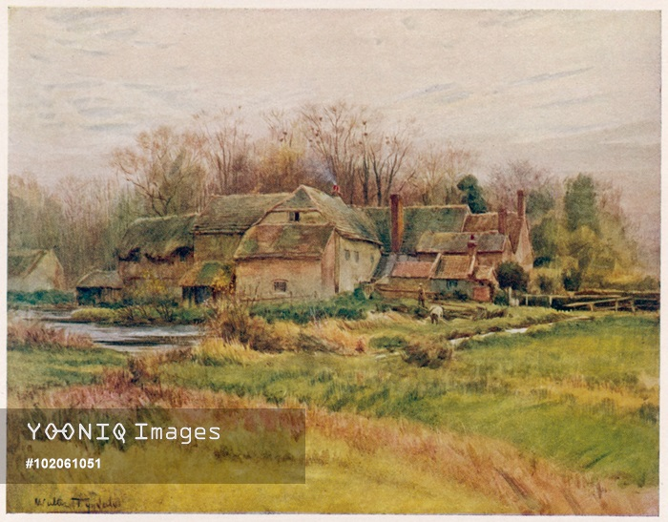
The Slopes
“a country-house built for enjoyment pure and simple, with not an acre of troublesome land attached to it”
symbolism of the name
keeps the ancient and therefore pure and enduring out/forgotten
across “the soft azure landscape of The Chase…one of the few remaining woodlands in England…Druidical mistletoe…enormous yew-trees….however, though visible from The Slopes, was outside the immediate boundaries of the estate.”
Talbothays
“it was necessary to descend into its midst…[the] verdant flatness…the placid valley”
the dairy farm is in the middle of a valley that is very alive
the buildings seems to be part of the landscape
“Long thatched sheds stretched round the enclosure, their slopes encrusted with vivid green moss”

Slide 6
Comparison of Male Suitors

Slide 7
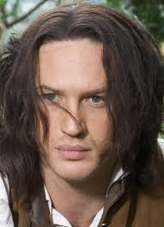
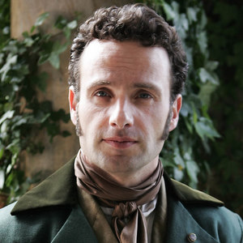
Heathcliff
Edgar Linton
- has a wild appearance – is passionate and has vitality
- has the appearance of being good – equated with weakness, gullibility, placidity
“tall, athletic, well-formed man; beside whom my master [Edgar] seemed quite slender and youth-like….His countenance was much older in expression and decision of feature than Mr. Linton's; it looked intelligent, and retained no marks of former degradation. A half-civilised ferocity lurked yet in the depressed brows and eyes full of black fire, but it was subdued”
“ ‘Cathy, this lamb of your threatens like a bull!’….Mr. Edgar was taken with a nervous trembling, and his countenance grew pale…He leant on the back of a chair, and covered his face.”

Slide 8
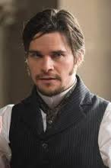
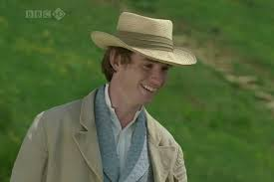
Alec d'Urberville
Angel Clare
good
honest
connected to the land
deceitful
morally corrupt
flirtatious – leads Tess into bad situations
“his object being to acquire a practical skill in the various processes of farming, with a view either to the Colonies, or the tenure of a home-farm”
“He had an almost swarthy complexion….Despite the touches of barbarism in his contours, there was a singular force in the gentleman’s face, and his bold rolling eye.”
“Unexpectedly he began to like the outdoor life for its own sake, and for what it brought….he became wonderfully free from the chronic melancholy which is taking hold of the civilized races”

Slide 9
Effects on relationships and love

Slide 10
Wuthering Heights
marriage based upon passion
marriage of equals
“My love for Linton is like the foliage in the woods: time will change it, I'm well aware, as winter changes the trees. My love for Heathcliff resembles the eternal rocks beneath: a source of little visible delight, but necessary. Nelly, I am Heathcliff.”
“Whatever our souls are made of, his and mine are the same; and Linton's is as different as a moonbeam from lightning, or frost from fire.”
“It was not the thorn bending to the honeysuckles, but the honeysuckles embracing the thorn. There were no mutual concessions; one stood erect, and the others yielded”

Slide 11
Tess of the d’Urbervilles
- relationship based on not only physical desire and covetousness
“Had she perceived this meeting’s import she might have asked why she was doomed to be seen and coveted that day by the wrong man, and not by some other man, the right and desired one in all respects”
“You have been the cause of my backsliding…you should be willing to share it, and leave that mule you call husband for ever….Remember…I was your master once! I will be your master again.”
“Though not cold-natured, he was rather bright than hot—less Byronic than Shelleyan; could love desperately, but his love more especially inclined to the imaginative and ethereal.”

Slide 12
Conclusion
Resolution and reconciliation at the end?
nature is the purer force – brings revival, life etc. But losing power
Cathy and Hareton end up together – a bringing together of not only the families but the 2 worlds (modern and old)
Death of Alec at Tess’ hands suggests that modernity can be overcome; but her own death on the altar at Stonehenge suggests that nature is losing power, stuck in the past; some remaining hope is provided in her sister and Angel

